Slide 1


Slide 2
A Presentation by
Abdul Basith
Manoj A B
Vinay Mane
Suraj
Roslet

Slide 3



Corporate Overview
160
Business Overview
YEARS OF EXPERIENCE
Industry Overview

Slide 4

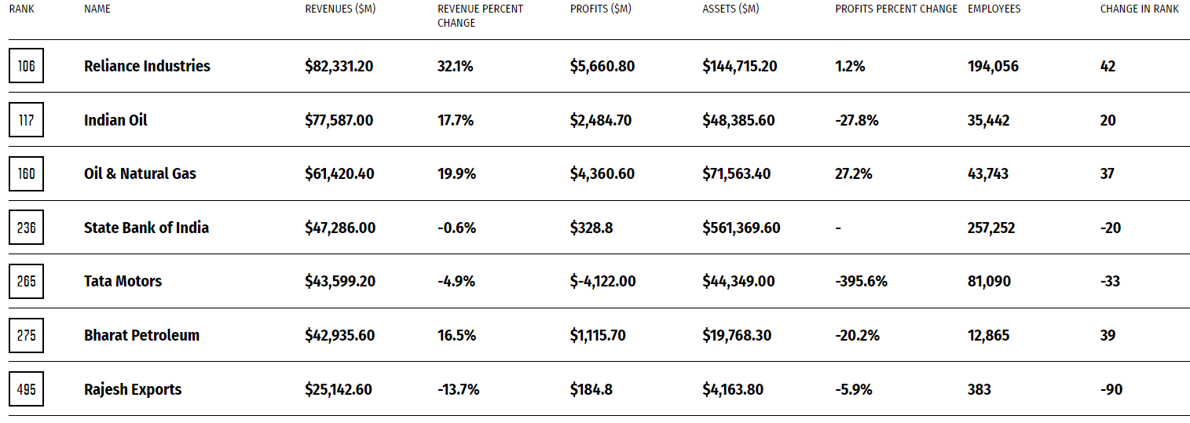
Indian Companies in
GLOBAL 500

Slide 5
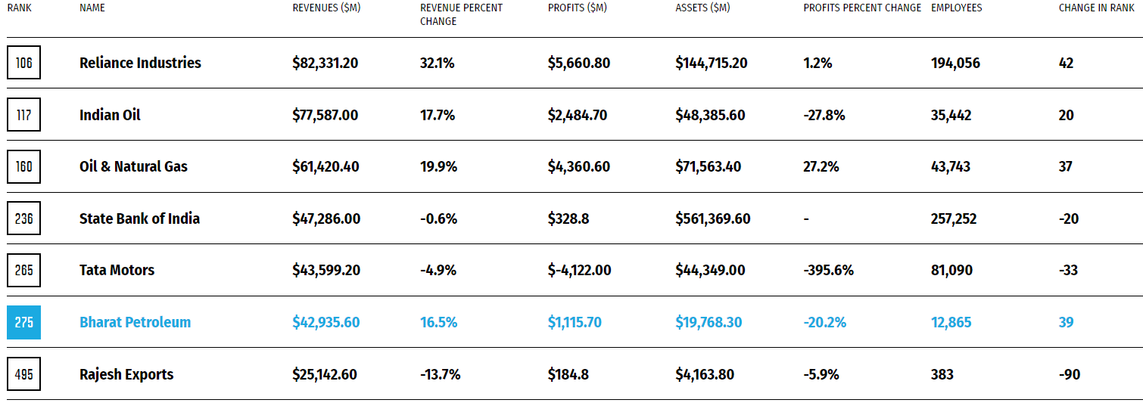
Indian Companies in
GLOBAL 500

Slide 6
In MMT
In MMT
In Bn ₹
Market Sales
Refining Capacity
Market Cap

Slide 7
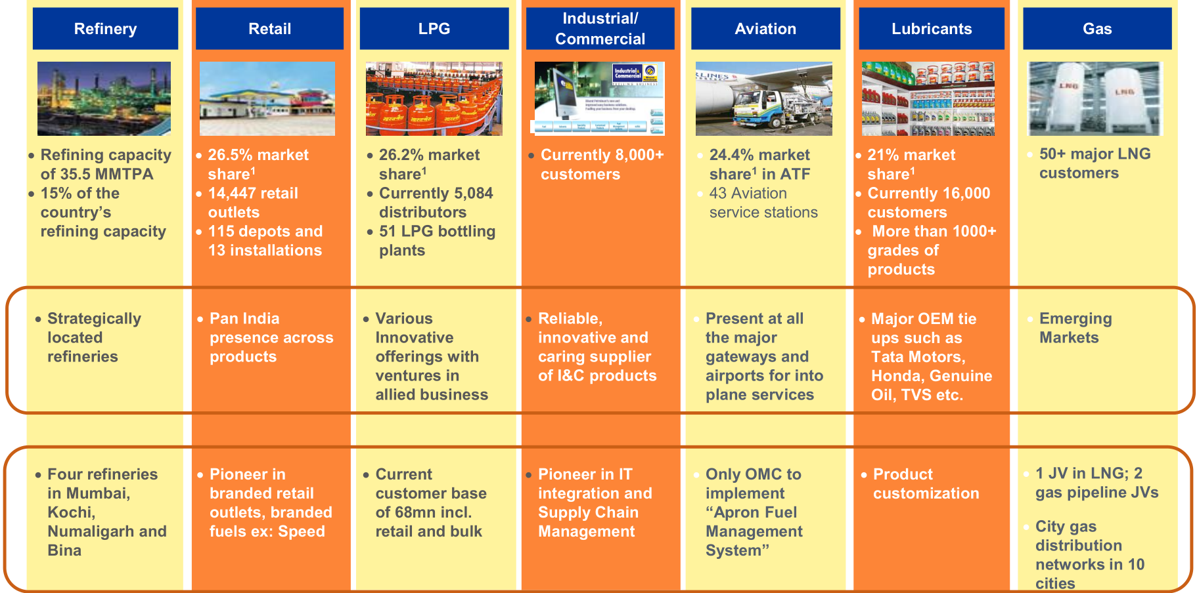
Diversified Product Offering and Presence Across Value Chain

Slide 8






Efficient Marketing Operations and Infrastructure
TR
Retail Initiatives
Brand & Customer Loyalty
New Business Initiatives
Technology Initiatives

Slide 9
India Oil Demand
In MMT

Slide 10
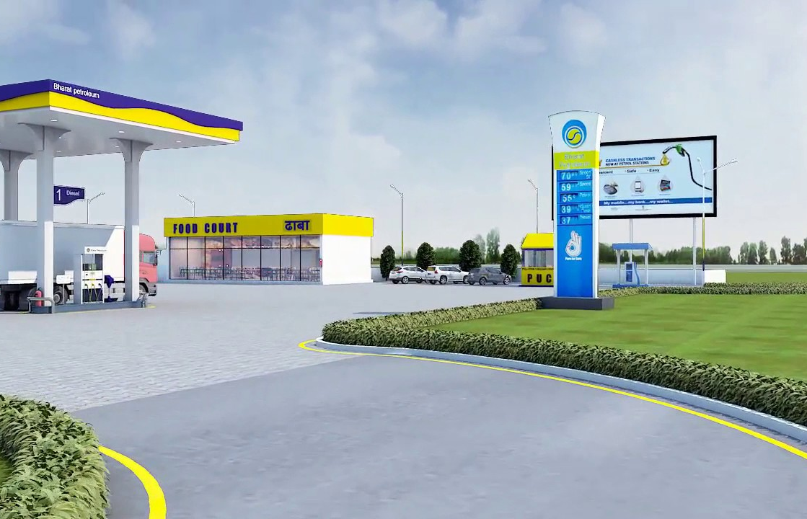
Thank You

